Slide 1
Statistical Modeling and Anomaly Detection in Smart Energy Consumption Data
MTech Machine Learning and Computing, IIST, Thiruvananthapuram
Presenters
—
Arish Muthukumar (SC25M159)
Veenus K K (SC25M171)
Course
—
MA643
Statistical Models Lab
Presenters
—
Dr. Raju K. George
Professor

Slide 2
OBJECTIVE
To predict Power consumption from
Household Electric Consumption features
(Voltage, Global active power, Global reactive power,etc..)

Slide 3
METHODOLOGY
Exploratory Data Analysis
Use different techniques
Select best model
Interpret using SHAP

Slide 4
Exploratory Data Analysis (EDA)

Slide 5
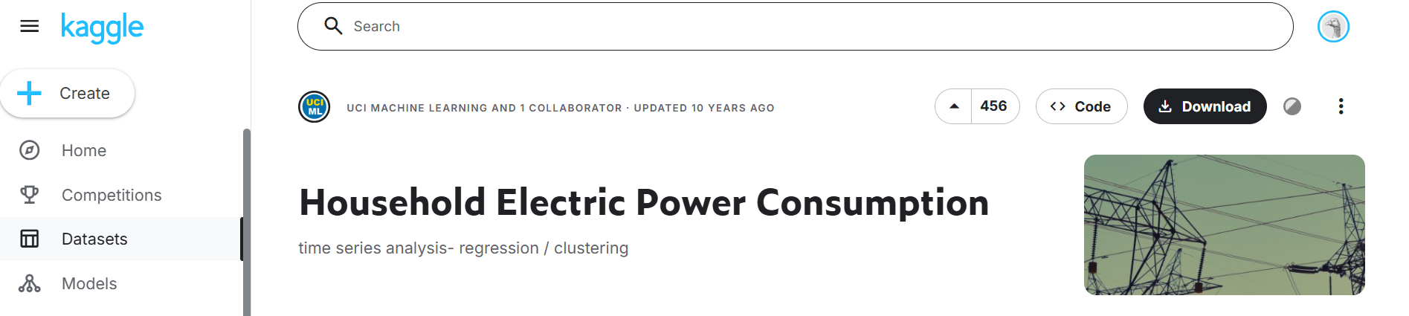
DATA SOURCE
Data Set Information:
This Dataset contains 2075259 measurements gathered between December 2006 and November 2010 (47 months).
Notes:
1.(global_active_power*1000/60 - sub_metering_1 - sub_metering_2 - sub_metering_3) represents the active energy consumed every minute (in watt hour).
2.The dataset contains some missing values in the measurements (nearly 1.25% of the rows).

Slide 6

DATA OVERVIEW
1.date: Date in format dd/mm/yyyy
2.time: time in format hh:mm:ss
3.global_active_power: Averaged active power (in kilowatt)
4.global_reactive_power: Averaged reactive power (in kilowatt)
5.voltage: Minute-averaged voltage (in volt)
6.global_intensity: Averaged current intensity (in ampere)
7.sub_metering_1: Kitchen (Dishwasher, oven).
8.sub_metering_2: Laundry room (Washing-machine,Drier, Refrigerator, Light).
9.sub_metering_3: Electric water-heater and an air-conditioner.

Slide 7
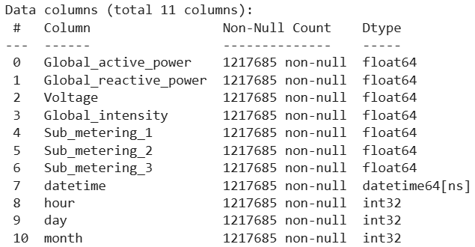
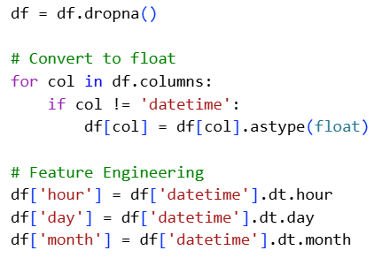
DATA CLEANING
Removing columns with high missing values
Converts all features into numerical format
Extracts time-based features from datetime
hour → captures daily pattern (peak hours)
day → captures daily variation
month → captures seasonal trends

Slide 8
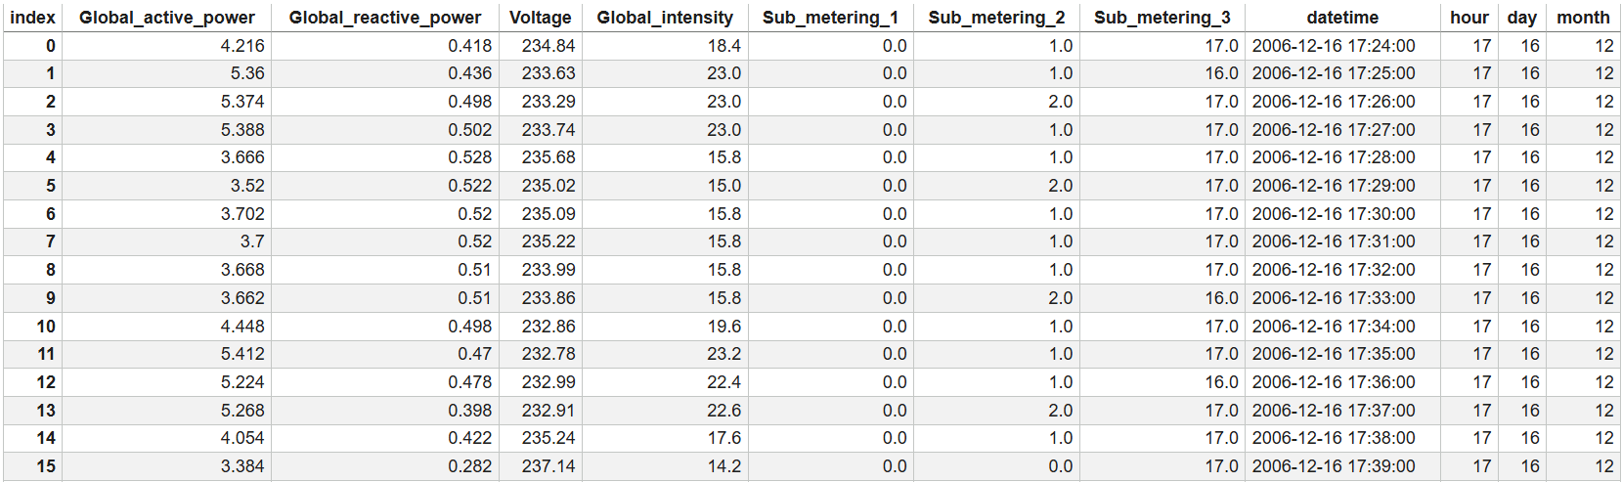
RAW DATA

Slide 9

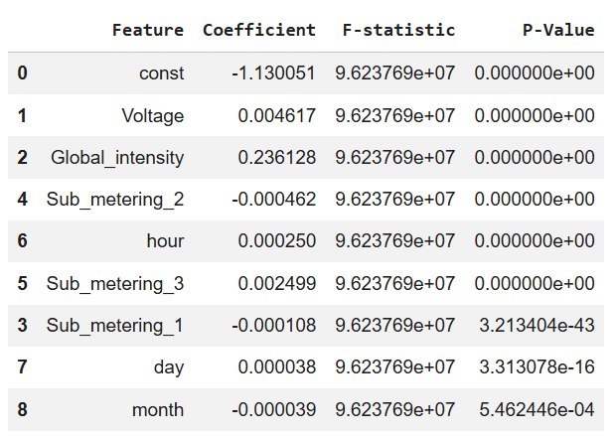
STATISTICAL SIGNIFICANCE
F-Statistic
Checks if the entire model is useful or not
High F-value → model is good
Low p-value (< 0.05) → statistically significant
p-value (for each feature)
Tells whether a feature is important
p < 0.05 → Important feature
p > 0.05 → Not significant

Slide 10
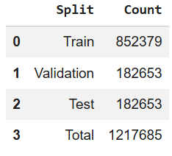
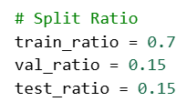
DATA SPLITTING

Slide 11
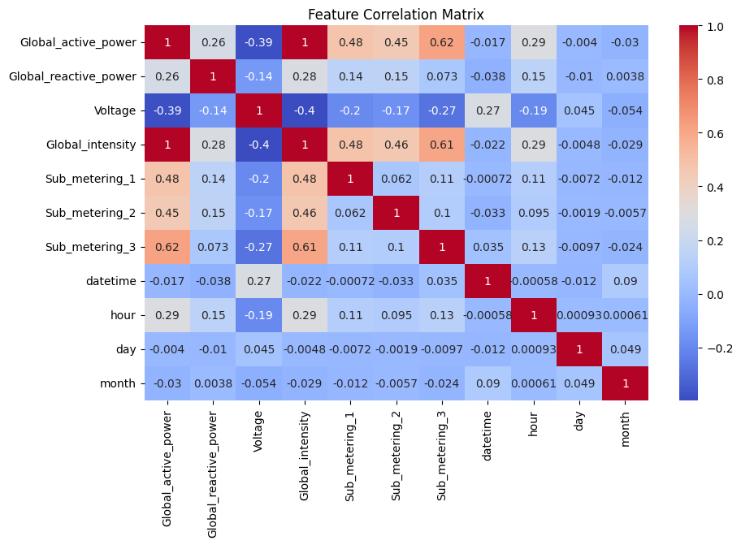
FEATURE CORRELATION MATRIX
The correlation matrix shows relationships between features.
We used it to identify important predictors and detect multicollinearity among variables.
Feature Importance
High correlation with target → useful feature
Multicollinearity
High correlation between features → problem
Causes unstable models
Solution:
Remove features OR
Use PCA

Slide 12
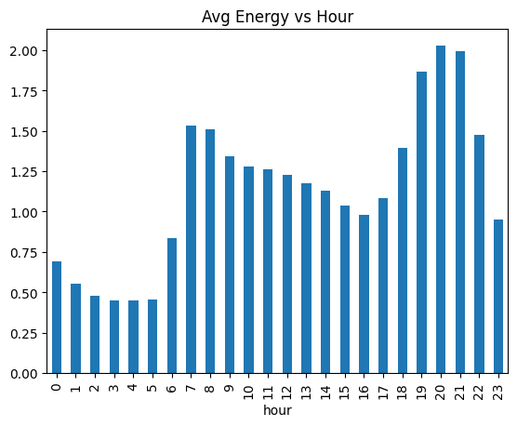
EDA (VISUALIZATION)

Slide 13
MODEL TRAINING

Slide 14
MODELLING TECHNIQUES
Linear Regression
RandomForest
XGBoost

Slide 15
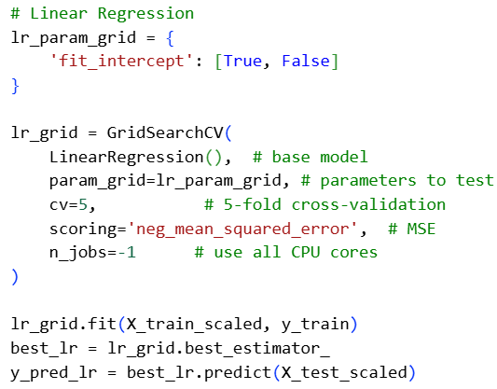
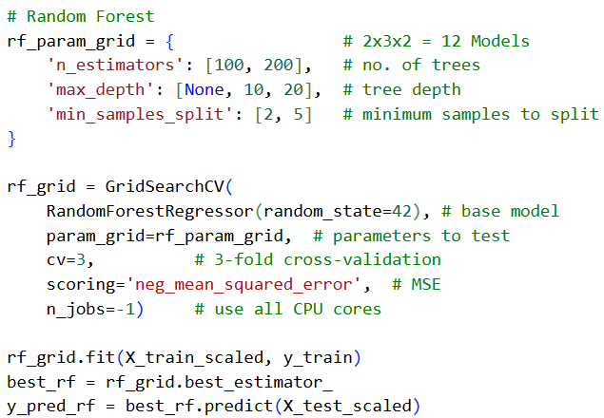

HYPERPARAMETER TUNING

Slide 16
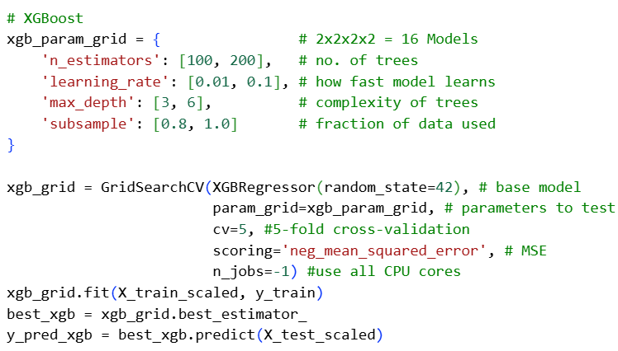
HYPERPARAMETER TUNING

Slide 17
EVALUATION

Slide 18
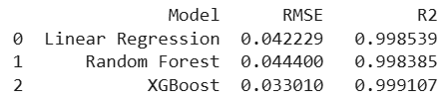
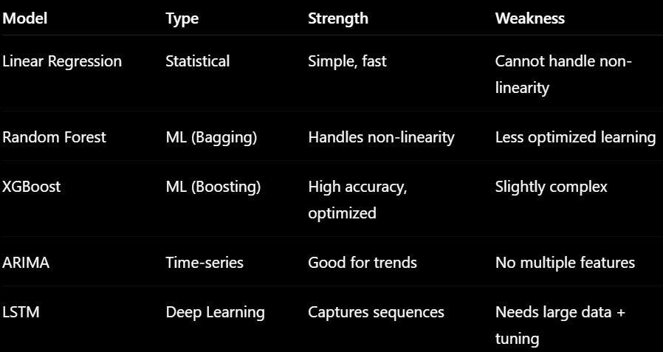
METRICS
RMSE (Root Mean Square Error)
Checks accuracy
Tells how far the prediction are from actual values
R2 Score (Coefficient of Determination)
Checks model strength
Measures how well the model explains the data

Slide 19
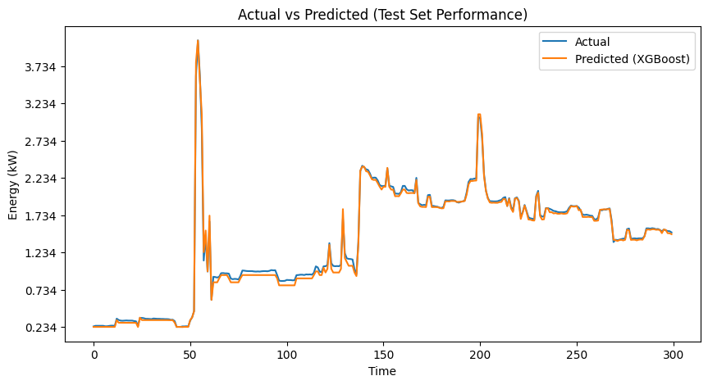
BEST MODEL

Slide 20
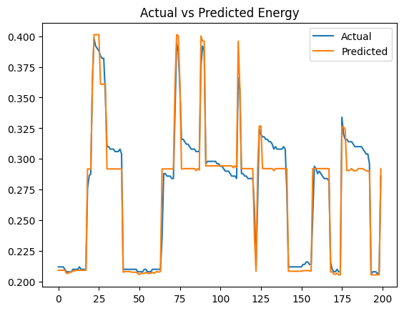
BEST MODEL
Model captures overall pattern.
Model detected sudden high usage.
Small Deviation.
Model performs very well in stable conditions.

Slide 21
INTERPRETABILITY

Slide 22
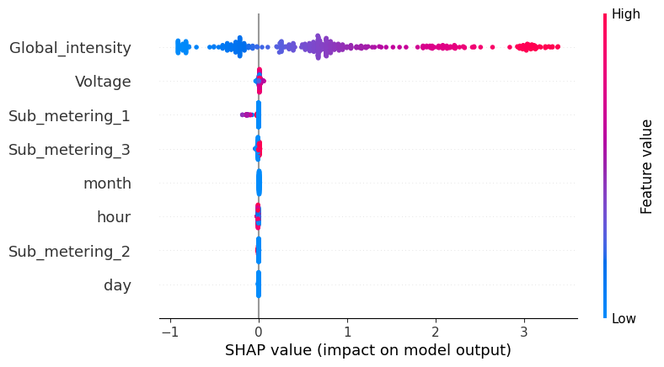
SHAP INTERPRETATION
SHAP (SHapley Additive exPlanations) interaction plots are advanced visualization tools used to understand how pairs of features jointly influence the predictions of a machine learning model.
Global_intensity (Red → Right)
High current → high energy
Hour (Evening → Right)
Peak hours increase load
Voltage (Mixed effect)
Less impact

Slide 23
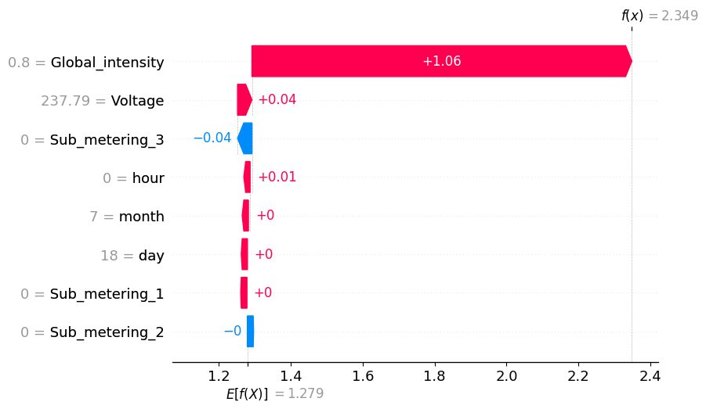
SHAP INTERPRETATION
This is a SHAP Waterfall Plot explains one single prediction made by your model (XGBoost)
Base vale
E[f(x)] = 1.279
Average prediction of the model
Final Prediction
f(x) = 2.349
Actual predicted value for this data point
Feature Contributions
Each bar shows how a feature pushes the prediction up or down

Slide 24
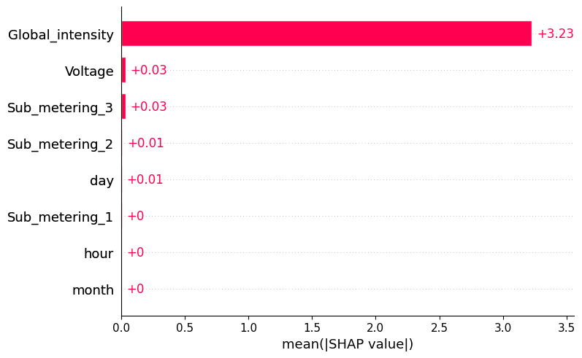
SHAP INTERPRETATION
This is a SHAP Feature Importance (Bar Plot) explains the overall (global) importance of features across the entire dataset, not just one prediction.
Mean absolute SHAP value
=
Average impact of a feature on prediction.

Slide 25
LIMITATIONS
Limited Dataset Scope : The model may not generalize to all real-world scenarios.
No External Factors : Factors like weather or occupancy are not included in the model.
Model Depends on Data Quality : The performance depends on the quality of the input data.
Static Model : The model is trained once and does not update dynamically.

Slide 26
CONCLUSION
Developed an accurate energy consumption prediction model using mathematical and ML techniques.
Compared multiple models (Linear, RF, XGBoost).
XGBoost achieved best performance with lowest error and high reliability.
SHAP analysis identified key factors influencing energy usage.
Demonstrated effective data-driven energy optimization and decision support.

Slide 27
REFERENCE
[1] UCI Machine Learning Repository Individual Household Electric Power Consumption Datasete
[2] Scikit-learn Documentation
[3] XGBoost Documentation
[4] Statsmodels Documentation

Slide 28
THANKS

